Slide 1


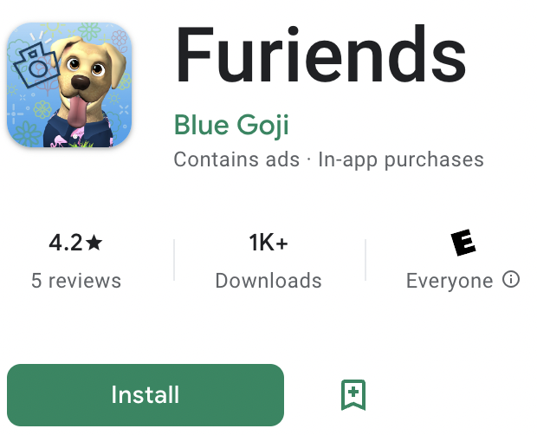
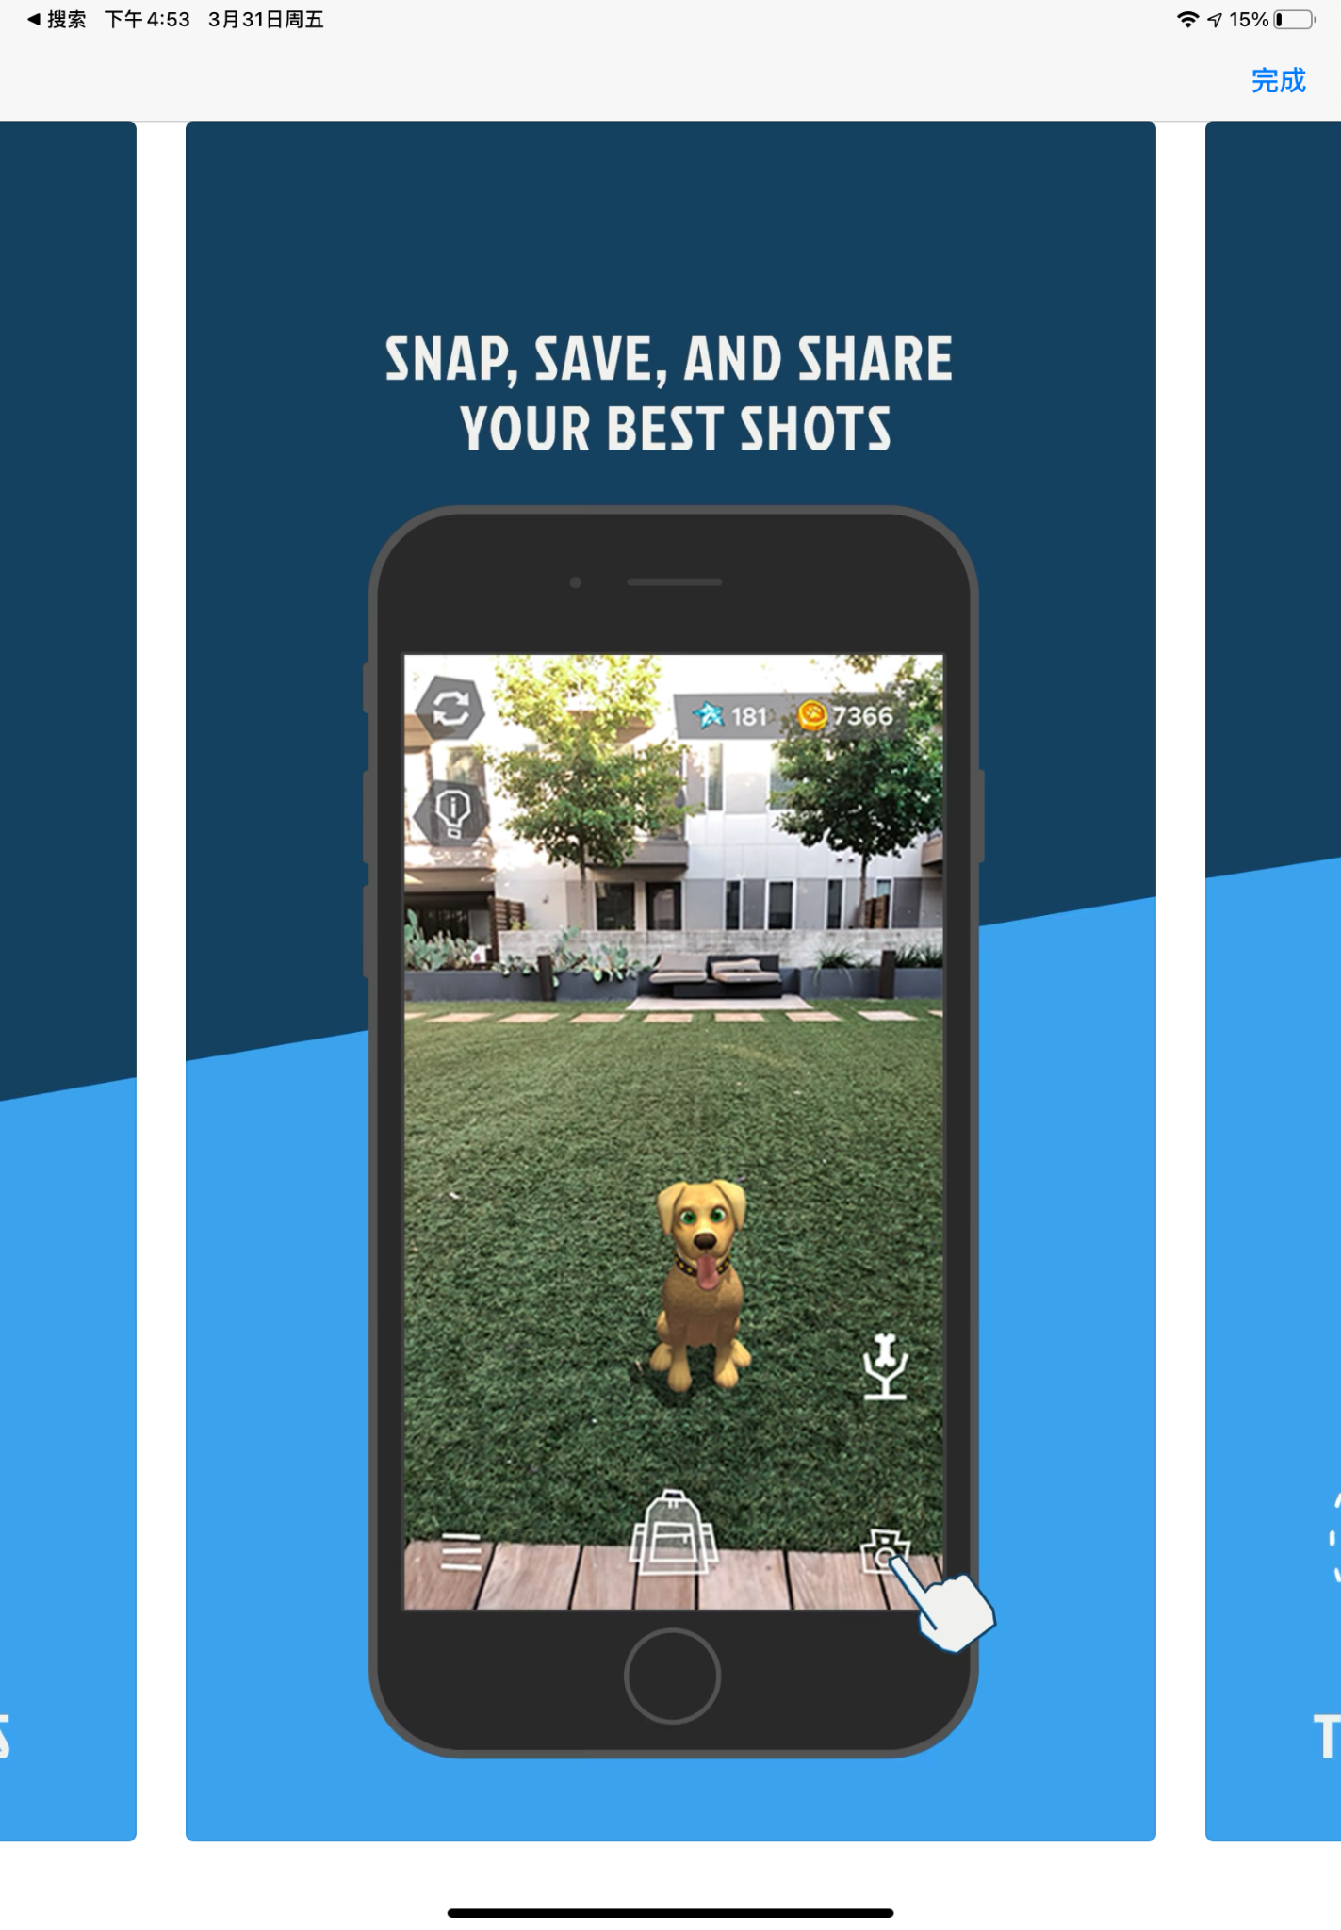

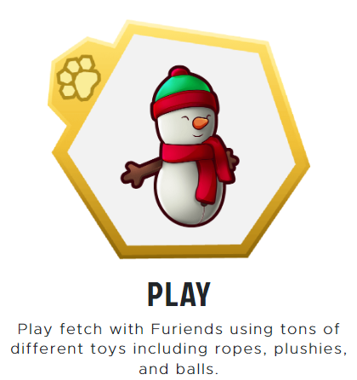




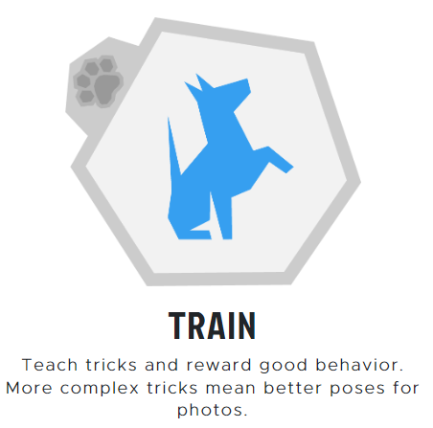
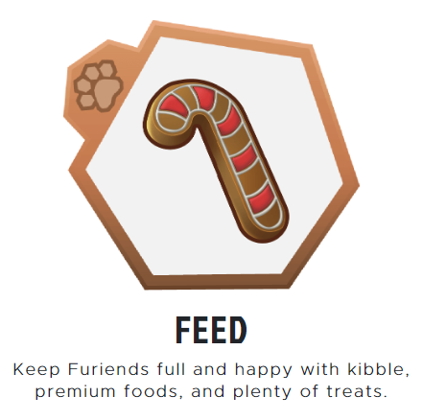
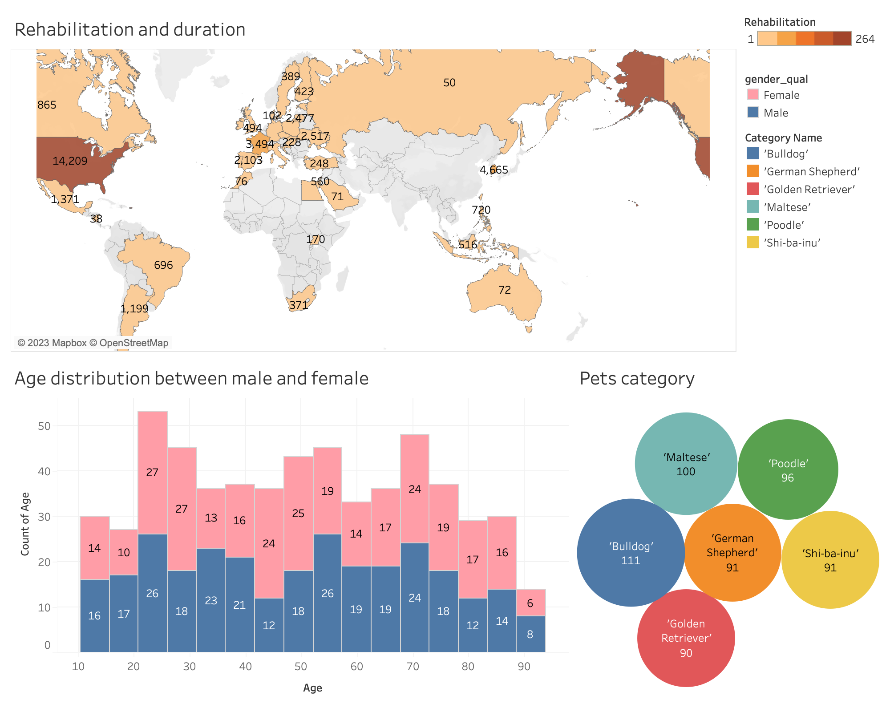
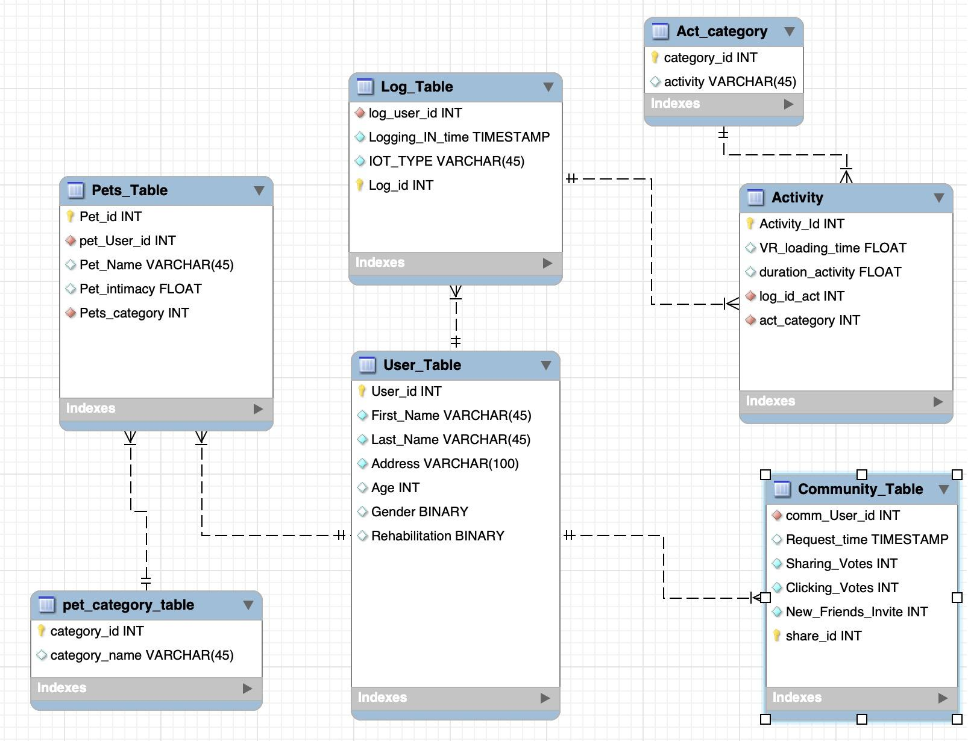
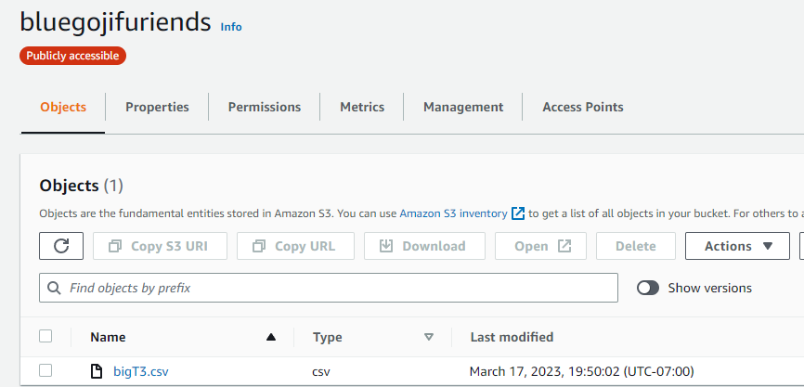
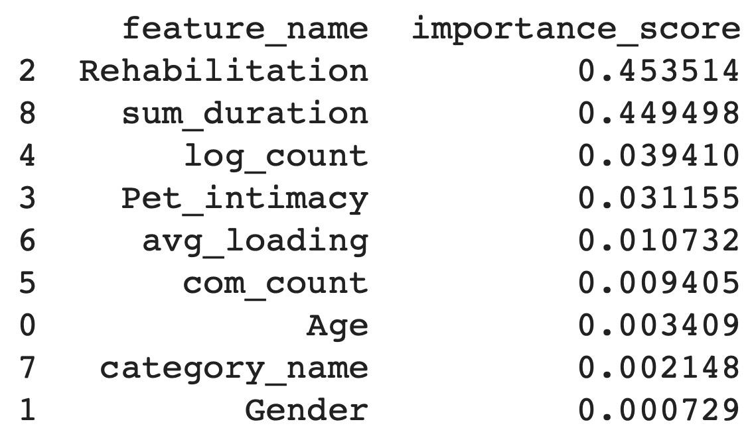

Boosting Physical Wellness Activity via ML/AI-based VR Dogs App
Team Member:
Anqi Fan(IEOR), Fan Fei(IEOR), Lingxiao Pan(ME),
Solar Shao(IEOR),Xiaojian Li(IEOR), Sining Shen(IEOR),
Yannan Niu(IEOR), Yiting Gan(IEOR)
Advisors:
Victor Detavernier(Blue Goji) & Gabriel Gomes(UC Berkeley ME)
Summary: Furiends is a mobile game where users adopt virtual dogs and are incentivized to be physically active. The project team plans to use machine learning to analyze user data and develop a user stickiness strategy to enhance the game's design and functionality. The goal is to motivate users to exercise more and engage with the game and keep them coming back through personalized rewards and social features.
The more you stay active, the more Furcoins you can get, the more you can spoil your pet!
STEP1: Designing data schema & creating database
We generated synthetic data to simulate user actions due to unavailability of real data.
To effectively store and organize this data, we created database schema based on user stickiness related metrics and store the data in.
Apply AWS S3 services to make data storage more safer, scalable and accessible..
STEP2: Extracting and cleaning data
We wrote Python code to perform data preprocessing and used Tableau to visualize the data, which was necessary before modeling.
Figure1: ER Diagram and AWS S3
Figure 2: Dashboard Visualization
What We Do?
STEP 4: Improving the App
We used the identified insights from modeling to propose improvement suggestions so that Furiends could attract more users and keep the registered users active.
STEP 3: Modeling
To find important features that affect users’ satisfaction, we applied three different machine learning models to perform data analysis:
Linear Regression
Random Forest
Neural Network
Linear Regression provides sufficient interpretability and fast training time. On this basis, Random Forest and Neural Network provide better precision and accuracy.
Figure 3: Features Ranking
Market & Business Value
Furiends and Blue Goji’s current mature products and fields have deep connections. In the future, our application can serve additional rehabilitation purposes by assisting individuals in performing rehab tasks while enabling physical therapists to monitor their exercise routines. By leveraging our expertise in machine learning, we can customize activity recommendations based on user's preferences and interests.
Since the rehabilitation training game is still a blue ocean, Furiends, a mobile game that encourages physical activity, has the potential to tap into the growing markets of mobile gaming and fitness. By using machine learning and social features to create a personalized and engaging experience, the app can increase user engagement and retention, leading to potential revenue growth for the company. At the same time, the word-of-mouth established by Furiends will also bring reputational value to other games and products of Blue Goji, and even bring considerable advertising revenue.

